Slide 1


Climate Change and Maternal Health Monitoring
AI PIONEERS
6-10-2024

Slide 2

INTRODUCTION
To develop a project on "Climate Change and Maternal Health Monitoring" using Python, matplotlib, pandas, and dash, you can structure it as follows. This project aims to monitor how climate change factors (e.g., heatwaves, floods, droughts) impact maternal health, using data visualization to provide insights.

Slide 3

TEAM MEMBERS
> NOYAL MATHEW JAIN
> SHAWN SAJI VARUGHESE
> ANEETTA PRASAD
> LAKSHMY RAJEEV
> HAFEES MUHAMMED
> ROHITH DILEEP

Slide 4
Climate Change and Its Impacts
Definition of Climate Change
Climate change refers to long-term shifts in temperatures and weather patterns, primarily driven by human activities, especially fossil fuel burning, deforestation, and industrial processes.
Key Impacts
Rising Temperatures: Global average temperatures have increased, leading to heatwaves and altering ecosystems.
Extreme Weather: Increased frequency and intensity of events such as hurricanes, floods, and droughts disrupt communities and infrastructure.
Food Insecurity: Changing climate conditions affect agricultural productivity, leading to food shortages and higher prices, disproportionately impacting vulnerable populations.

Slide 5
DIRECT IMPACT ON METERNAL HEALTH
Disruption of Healthcare Services
Extreme weather events can damage healthcare infrastructure and impede access to care.
Increased Respiratory Issues
Poor air quality from pollution leads to complications like asthma and other respiratory conditions.
INDIRECT IMPACT ON METERNAL HEALTH
Food Insecurity
Climate change affects agricultural yields, leading to malnutrition and insufficient nutrient intake for pregnant individuals.
Economic Instability
Disruptions in local economies due to climate events can limit access to healthcare and essential services.

Slide 6
Monitoring Strategies
Integrating Climate Data into Health Systems
Data Fusion: Incorporate climate data (e.g., temperature, air quality, extreme weather events) into existing maternal health monitoring systems to identify correlations and trends.
Predictive Analytics: Use data analytics to forecast potential health impacts based on climate projections, enabling proactive healthcare planning.
Community Engagement and Participation
Local Involvement: Involve community members in identifying climate-related health risks and solutions tailored to their specific needs.
Education and Awareness: Conduct workshops and training sessions to raise awareness about the impacts of climate change on maternal health and promote adaptive behaviors.

Slide 7
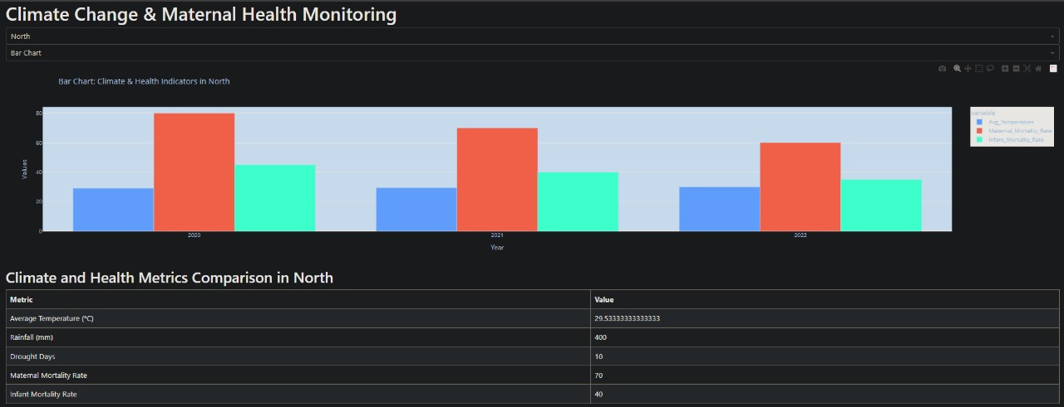
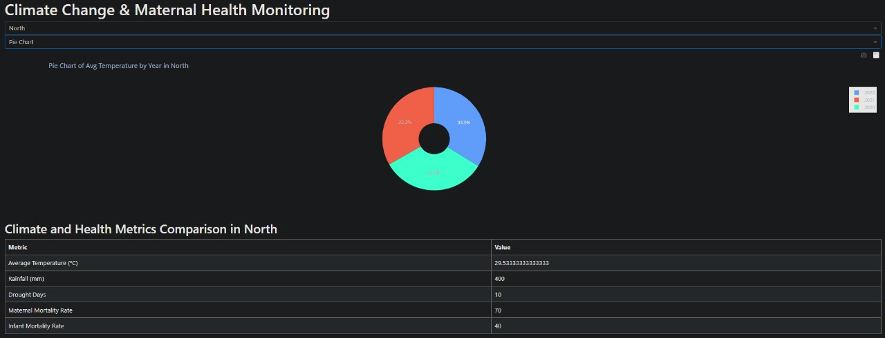


DEMO
LIBRARIES USED
>import dash from dash > import dcc, html from dash.dependencies >import Input, Output import dash_bootstrap_components as dbc
> import plotly.express as px
> import pandas as pd >import numpy as np

Slide 8
CONCLUSION
This project framework provides a comprehensive approach to analyzing and visualizing the impact of climate change on maternal health. By utilizing Python libraries, you can create an interactive dashboard that offers insights and facilitates discussions on this critical issue. Adjust the details based on your specific data sources and analysis requirements!
REFERENCES
Wikipedia
Chatgpt
Nasa Global Climate Change

